Slide 1
Can stimulus saliency modulates the spiking activity of visual cortex
小组成员：程宇昂 陈健柏 林逍屹 梅子杰

Slide 2
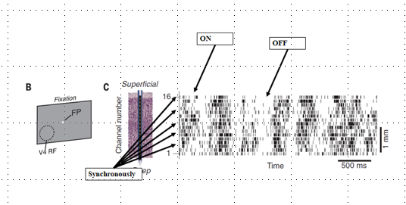
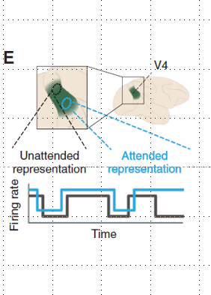
Background

Slide 3
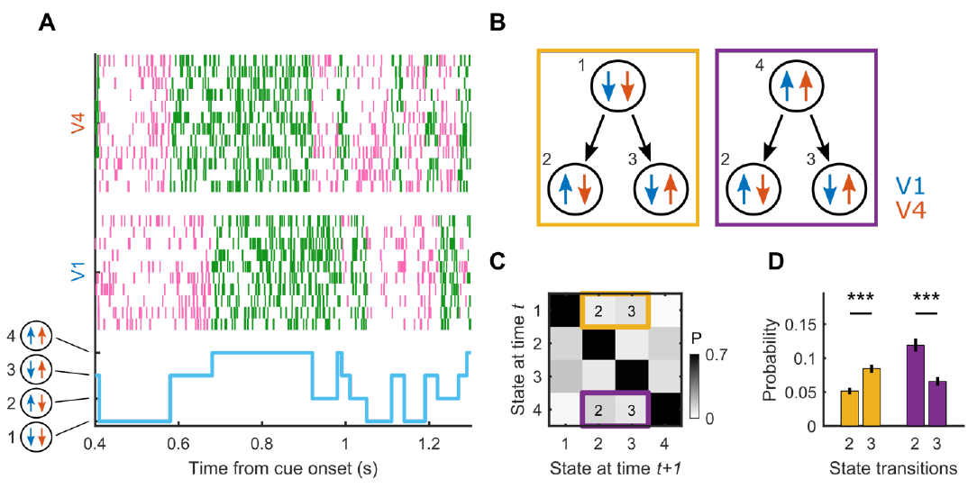
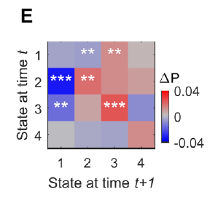
Background

Slide 4
Hypothesis
During a bottom-up task, forward projections rather than backward projections are dominant.
The backward projections, reflecting the coordination of visual cortex, are modulated by the stimulus saliency.

Slide 5
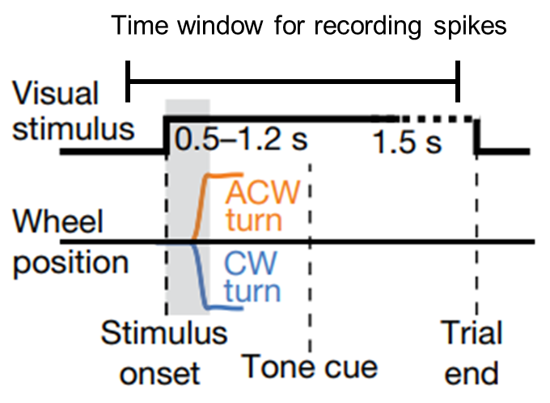
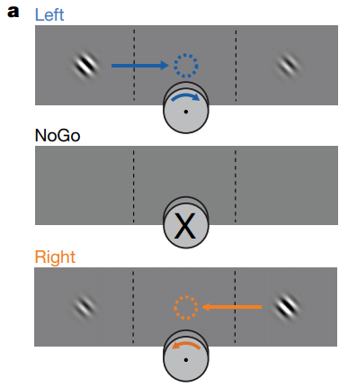
Task and psychophysical results
Steinmetz et al., 2019

Slide 6
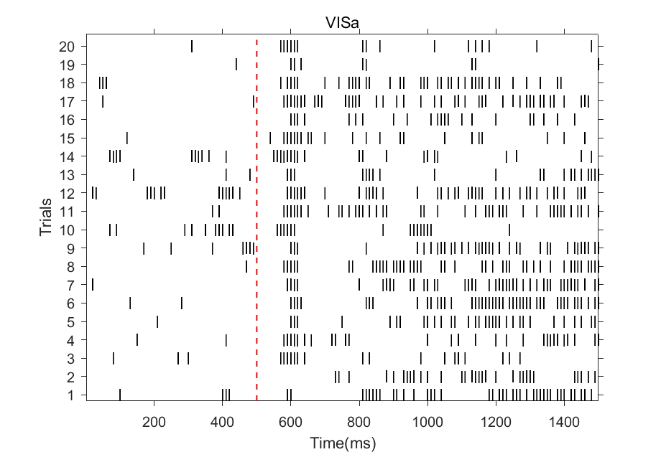
Raster plot

Slide 7
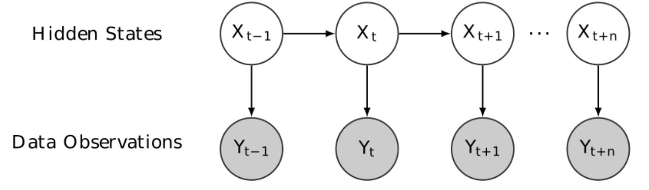
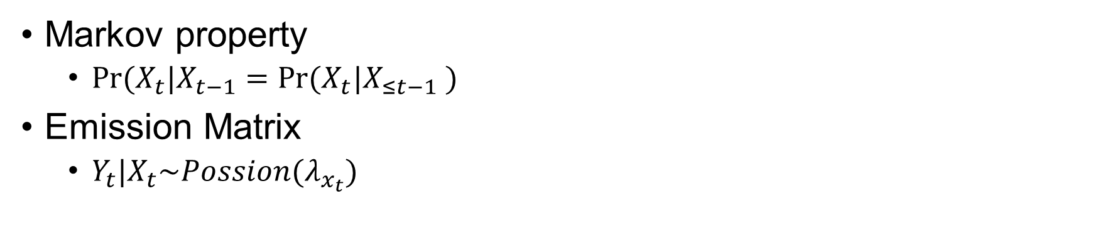
Hidden Markov Model
Markov property
$Pr⁡(X_{t}|X_{t−1}=Pr⁡(X_{t}|X_{≤t−1} )$
Emission Matrix
$Y_{t}|X_{t}\sim Possion(λ_{x_{t}})$

